Slide 1
Exploring updating behaviours of trial sponsors for trials registered in the Australian New Zealand Clinical Trials Registry
Angie Barba, Peta Skeers, Ava Grace Tan-Koay, Sherrie Liu, Melina Willson
Notes:
Hello, my name is Angie Barba and I am part of the Evidence Integration team at the NHMRC Clinical Trials Centre at the University of Sydney, where I am also affiliated with the Australian New Zealand Clinical Trials Registry.
It is my pleasure to present to you today on a project exploring updating behaviours of trial sponsors for trials registered in the ANZCTR.

Slide 2
Notes:
First I would like to acknowledge…

Slide 3
The project
To maximise the utility of the information available the ANZCTR, it is essential that information is current and reliable.
The ANZCTR is a Primary Registry with the WHO Registry Network.
Notes:
To maximise the utility of the information available on the over 24,000 studies registered with the Australian New Zealand Clinical Trials Registry (or ANZCTR) for the public, funders, and researchers, it is essential that information is current and reliable.
Briefly, the ANZCTR is a Primary Registry with the World Health Organisation Registry Network, that has existed since 2005. The registry, along with 16 other registries globally collect data on trials, including intervention details, outcomes, sponsor information, recruitment information and much more.
The role of registries like the ANZCTR, has evolved over time. What commenced initially as a register of trials has developed to also be a platform for open science for trials providing data sharing details, and a results reporting database.
These are important roles to ensure transparency of clinical trials and reduce research waste.
Therefore, our aim was to understand the updating behaviours of trial sponsors in the ANZCTR and, where required, develop recommendations to facilitate updating of trials.

Slide 4
The project - methods
Study population: All interventional trials registered with the ANZCTR from 2015 to 2022.
Total studies registered = 23,162
Notes:
For this project, we limited the data to use interventional trials registered with the ANZCTR from 2015 to 2022.
We wanted to stick to relatively recent data as the registry fields and requirements have changed substantially since the beginning of the registry, awareness of the registry has grown over time, and we wanted to have a snapshot of current updating behaviours.
Observational studies were also removed as there are no requirements to register these studies in a registry.
And finally, studies considered ‘withdrawn’ were also removed from the dataset. These studies are those that investigators registered, however have since advised that they will no longer go ahead.

Slide 5
Have trials updated?
Total interventional trials = 11,037
Notes:
Our first point of interest was looking at how often trial records were updated, if at all.
From 2015-2022 there were a total of 11,037 trials registered with the ANZCTR. Generally, when looking at all interventional trials, our analysis indicated that trial sponsors updated their records a median one time, with an IQR of 1-2 times.

Slide 6
The project
Total interventional trials = 11,037
Notes:
63% of these trials updated their registry information at least once, and as our primary aim was to understand the updating behaviours of trial sponsors in the ANZCTR, these are the trials that provided the majority of data to this project.

Slide 7
What is updated?
Notes:
We were first interested in looking at what was being updated in records.
For this, please note that when looking at the total number of updates made to all study records, each update to each field in a study record is counted once, therefore the number of updates made far outweighs the number of trials. This is because one record could have changed each every field in the form (of which there are over 100), and each update would be counted in this analysis.
In order to make better sense of the number of fields involved, we have grouped these updates into similar ‘buckets’ of fields, for example, all the start/finish dates are all grouped into one, changes to outcomes are grouped into one, and so on.

Slide 8
What is updated?
Note: percentages are of total updates made.
Notes:
Keeping this in mind, by far, the top 3 updated sections of the form are to do with trial recruitment, accounting for 51% of the total updates made in this time. This includes the stage of recruitment, dates of recruitment and sample sizes information.

Slide 9
What is updated?
Notes:
Changes to outcomes, this includes changes to assessment methods used, timepoints of assessment or removal or additions of outcomes, account for 6% of all updates made. This is the most updated field that reflects changes to study methodology.

Slide 10
What is updated?
Notes:
- Changes to the description of the intervention or control field account for 4% of updates

Slide 11
What is updated?
Notes:
- Provision of results information, including publication details or details of other methods of dissemination such as conferences, accounts for 4% of updates made

Slide 12
Recruitment stage
Notes:
As recruitment stage is a key field of interest, we looked into this in more detail.

Slide 13
Recruitment stage
From 2015 to 2022, 47% of trials updated their recruitment status to ‘completed’.
Notes:
For trials that had updated their records:
- 47% of trials updated to indicate that their trials were completed and 7% updated to stopped early, indicating that all participants had completed enrolment and all follow up data had been collected.
- 31% indicated their trial was recruiting,
- 10% remained ‘not yet recruiting’
- 6% were active, not recruiting, which is used to describe studies that have completed enrolment but are continuing to collect follow-up data, and
- 1% are suspended, used to indicate studies that have temporarily halted recruitment.

Slide 14
Recruitment stage
For trials that have never updated, the majority (61%) remain as ‘Not yet recruiting’.
Notes:
For the 37% of trials that have never updated, the vast majority (61%) remain as not yet recruiting, with only 22% marked as stopped early or completed.

Slide 15
Recruitment stage
For trials that have never updated, the majority (61%) remain as ‘Not yet recruiting’.
Notes:
When looking further at these trials, 28% were registered in 2022. For the remaining 1781 trials, these were registered prior to 2022 and are therefore out-of-date.

Slide 16
When do updates happen?
Notes:
Finally, we wanted to explore when these updates were occurring.

Slide 17
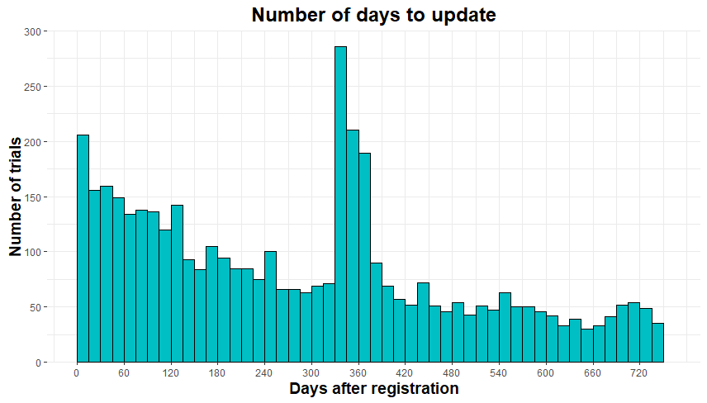
When do updates happen?
19% of all updates
Notes:
19% of updates occur 11-12 months after registration

Slide 18
When do updates happen?
Reminder email
Notes:
Which also coincides with automated update reminder emails registrants receive from the ANZCTR at 11 months

Slide 19
When do updates happen?
Annual Reminder emails
Notes:
…and additional automated reminder emails sent annually from registration until the study has updated the registry that they have completed recruitment and data collection is completed.
We were curious as to whether updates may be impacted by any possible reminders from other regulatory bodies. As the ANZCTR also collects data on ethics, and trials are increasingly registering prior to final ethics approval being obtained, we looked into whether there were any different trends for trials registered prior to ethics approval

Slide 20
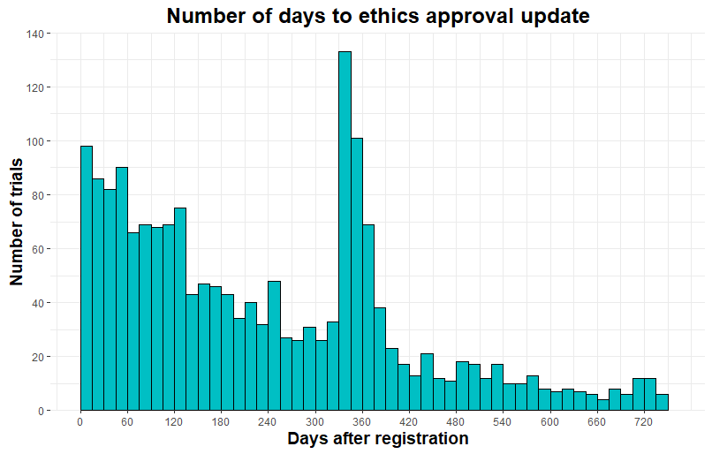
For those registered prior to ethics?
33% of trials
Notes:
Of the 1,903 trials registered without ethics approval, 33% provide details of ethics approval within 4 months of registration

Slide 21
For those registered prior to ethics?
14% of trials
Notes:
Followed by 14% at 11-12 months post-registration. After 12 months, 1% of trials provided ethics details per month.

Slide 22
Conclusions
Most trials update information once or twice in their life cycle
However, 1/3 of trials have never updated
Trials that do update mainly provide updates to recruitment
Reminders by the ANZCTR or regulatory bodies appear to have some impact

Slide 23
Conclusions
To encourage updates by trial sponsors, the ANZCTR will:
Tailor reminders targeting key trial milestones
Explore automating some updates
Develop guidance on trial reporting with funding bodies, regulatory bodies, and other relevant entities
Notes:
The ANZCTR, has been ‘bare bones’ for a number of years now, and we recognise that the updating function needs work.
Using this information, the ANZCTR will try and encourage updates by researchers by:
- Tailoring reminders targeting key trial milestones, focusing on dates of anticipated commencement, completion or reminders to provide details of results after a study is completed
- Explore automating some updates, to minimize administrative burden on researchers
and
- Develop guidance on trial reporting with funding bodies, regulatory bodies, and other relevant entities

Slide 24
Thank you!
Contact: angie.barba@sydney.edu.au
Notes:
Thank you for your time, and please get in touch if you have any questions!

